Slide 1
COMMON GUI FOR MULTIPLE DATABASES
Under the guidance of: BY:
N. Chaitanya Kumar SAI GEETIKA BHOGADI(1267)
Associate Professor SAI KOUMUDI(1269)
SINDHUJA(1272)

Slide 2
WHAT IS IT ABOUT ???
This project aims at creation of an automatic database schema generation. This project will be accessible to all developers.

Slide 3
NEED FOR IT !!!!!
There are many Database Management systems available today. The Database designer is familiar with any one of the database Management Systems.

Slide 4
PROPOSED SYSTEM
The Automatic Database Schema Generation System provides the following features:
The Automatic Database Schema Generation System provides a Common User Interface to interact with all the databases.
Here the user interface is Graphical User Interface.
This application is a Web based Application.
Being a web based application it doesn’t require any client side installation.
Any number of users can interact with the system simultaneously.
Using Session management the interaction more secure.

Slide 5
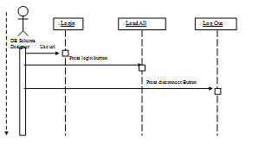
FLOW OF ACTIONS :

Slide 6
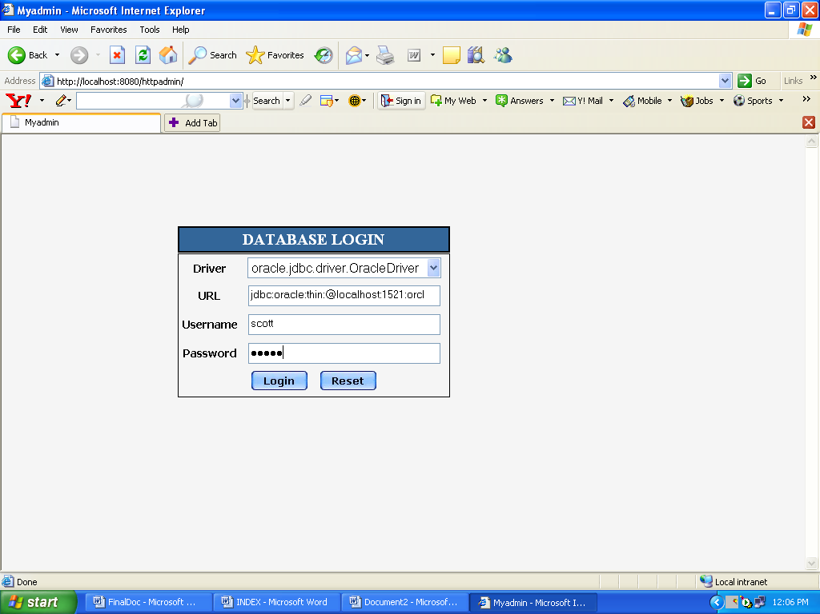
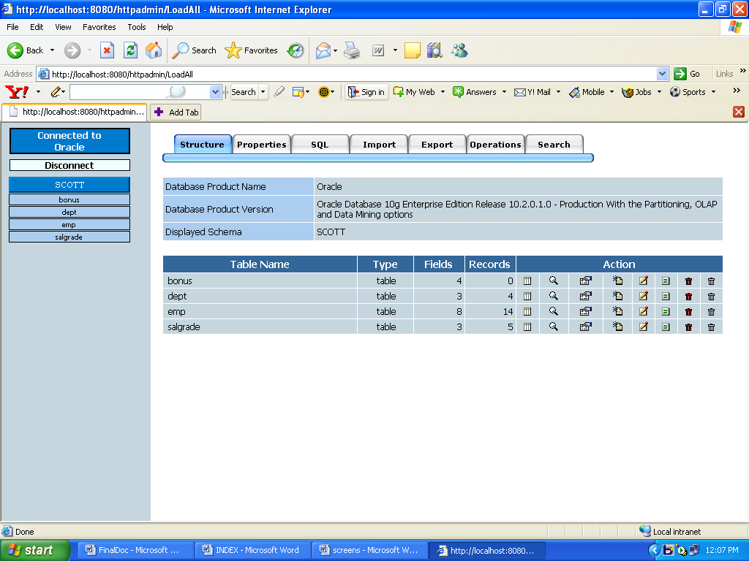
HOW DOES IT LOOK LIKE ????
LOGIN PAGE :
AFTER LOGGING IN:

Slide 7
WHAT ARE THE DIFFERENT OPTIONS PRESENT ????
STRUCTURE
PROPERTIES
SQL
IMPORT
EXPORT
OPERATIONS
SEARCH

Slide 8
BUTTONS USED…
Browse Drop Edit Empty
Export Insert Rename Search

Slide 9
WHAT SOFTWARES ARE USED ??
Server Side:
    - Platform Independent
    - Internet explorer 5.0 or above.
    - JDK 1.4 or higher.
    - Apache Tomcat Web Server 4.0 or above.
    - TCP/IP Protocol suite.
Client Side:
- Any Web Browser on any operating system.
Languages used :
We have used HTML to display the webpages and java servlets to validate the drop-downs .

Slide 10
ADVANTAGES …
Easy to use
Flexible
User need not be thorough with all the database management systems.
Consumes less time for accessing information
-Can easily import and export data from one database to another.

Slide 11
Database Tier: The concentration is applied by adopting wide range of DBMS.
User Tier: The user interface is developed in a browser specific environment to have web based architecture. The components are designed using HTML standards and Java server pages . Java Script for Loading graphics and Validations.
Data Base Connectivity Tier: The communication architecture is designed by concentration on the standards of servlets .The database connectivity is established using the JDBC .

Slide 12
FUTURE SCOPE
If two companies using different databases merge then there is a need for this type of application to make their work easier.
With the advancement of technology, there are many more things an dB administrator must concentrate on than learning all database management system.

Slide 13
THANK YOU

